Slide 1
Data Science Courses
Christodoulos Asiminidis
2022

Slide 2
What is a Data Science course
Client Requirements
Highlight important criteria
Easier explanation of technical concepts
Statistical Knowledge
Mathematics
Designing Methods
Tuning and Fitting the Model
Database languages
Data Governance
Data Preprocessing
Data validation
Data Infrastructure

Slide 3
What Data Science can be found?
Data Science in E-commerce
Data Science in manufacturing
Data Science as Conversational Agents
Data Science in Transport

Slide 4
Computer Vision Algorithms
Simple Moving Average
Weighted Moving Average
Exponential Moving Average
The equation of the simple moving average is the following one:
Simple Moving Average = (A₁ + A₂ + …… + A_{n}) / n
The formula for exponential moving average is the following one:
Weightage Moving Average = (A₁*W₁ + A₂*W₂ + …… + A_{n}*W_{n})
The exponential moving average is the following one:
Exponential Moving Average = (C – P) * (2 / (n + 1)) + P
Cropping, scaling and resizing are so far simple and wide image processing tools

Slide 5
Computer Vision Algorithms in Python
Cropping, scaling, grey_scale, moving average, weighted moving average and exponential average, blurry:
load the image, display it to our screen, and initialize a list of
# kernel sizes (so we can evaluate the relationship between kernel
# size and amount of blurring)
image = cv2.imread(args["image"])
cv2.imshow("Original", image)
kernelSizes = [(3, 3), (9, 9), (15, 15)]
# loop over the kernel sizes
for (kX, kY) in kernelSizes:
# apply an "average" blur to the image using the current kernel
# size
blurred = cv2.blur(image, (kX, kY))
cv2.imshow("Average ({}, {})".format(kX, kY), blurred)
cv2.waitKey(0)

Slide 6
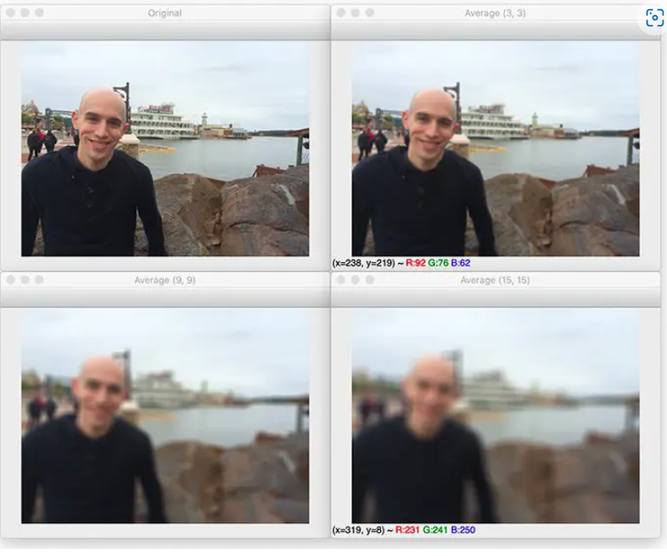
Computer Vision Algorithms Python Blurr Outcome

Slide 7
Computer Vision Algorithms – cv2.bilateralBlur()
# load the image, display it to our screen, and construct a list of
# bilateral filtering parameters that we are going to explore
image = cv2.imread(args["image"])
cv2.imshow("Original", image)
params = [(11, 21, 7), (11, 41, 21), (11, 61, 39)]
# loop over the diameter, sigma color, and sigma space
for (diameter, sigmaColor, sigmaSpace) in params:
# apply bilateral filtering to the image using the current set of
# parameters
blurred = cv2.bilateralFilter(image, diameter, sigmaColor, sigmaSpace)
# show the output image and associated parameters
title = "Blurred d={}, sc={}, ss={}".format(
diameter, sigmaColor, sigmaSpace)
cv2.imshow(title, blurred)
cv2.waitKey(0)

Slide 8
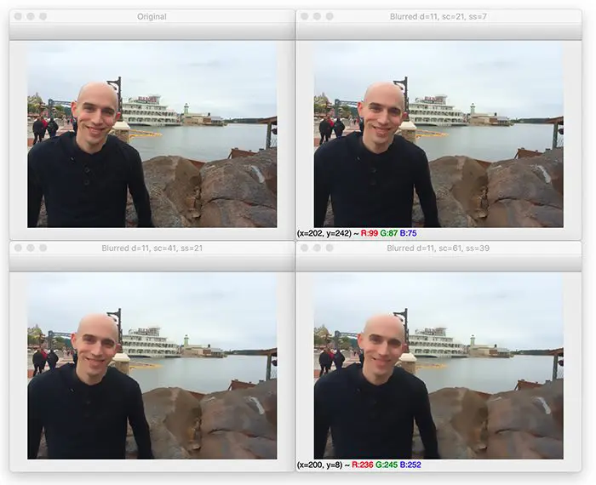
Computer Vision Algorithms – cv2.bilateralBlur() -
Goal: reduce image noise but edges remain the same.

Slide 9
Computer Vision Gaussian Blur Python – In order to reduce image noise
#Read Image img_second=cv2.imread("noiseimage.jpg")
In [6]:
#We are taking Kernel size as 5x5 gaussian_blur = cv2.GaussianBlur(img_second,(5,5),sigmaX=0)
In [7]:
#Display gaussian blur image window_name='imagesecond_blur’
cv2.namedWindow(window_name, cv2.WINDOW_NORMAL)
cv2.imshow(window_name,gaussian_blur)
cv2.waitKey(0)
cv2.destroyAllWindows()

Slide 10
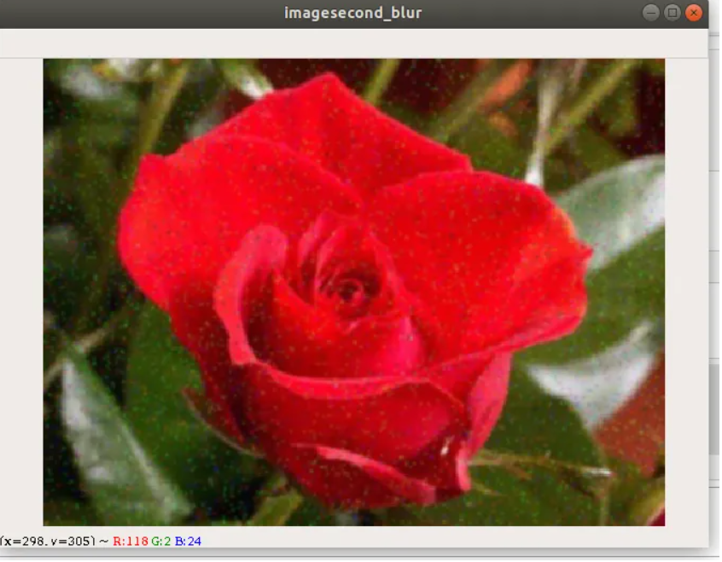
Computer Vision Gaussian Blur Outcome

Slide 11
Computer Vision Median Filter cv2.medianBlur()
Example of Smoothin Image using cv2.medianBlue()
Img_third = cv2.imread(“noiseimage.jpg”)
image_median = cv2.medianBlur(img_third,5)
Goal: Median Blurring always reduces the noise effectively because in this filtering technique the central element is always replaced by some pixel value in the image. But in the above filters, the central element is a newly calculated value which may be a pixel value in the image or a new value.

Slide 12
Computer Vision Median Filter cv2.medianBlur() (2)
#Display MedianBlurred image
window_name='MedianBlurrred'
cv2.namedWindow(window_name, cv2.WINDOW_NORMAL)
cv2.imshow(window_name,image_median)
cv2.waitKey(0)
cv2.destroyAllWindows()

Slide 13
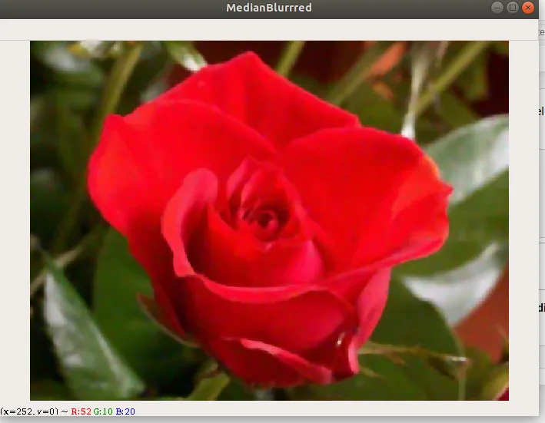
Computer Vision algorithms – Median Blur(0 cv2.medianBlur()

Slide 14
Thank you - QnA
Next course: More advanced Computer Vision Algorithms such as CNN, Yolo, SDD, etc.

